Slide 1
ELEMENTARY STATISTICS, BLUMAN
Stem and Leaf Plot
© 2019 McGraw-Hill Education. All rights reserved. Authorized only for instructor use in the classroom. No reproduction or further distribution permitted without the prior written consent of McGraw-Hill Education.

Slide 2
Objectives for this PowerPoint
Construct a stem and leaf plot.

Slide 3
Definition
A stem and leaf plot is a data plot that uses part of the data value as the stem and part of the data value as the leaf to form groups or classes.

Slide 4
Example
At an outpatient testing center, the number of cardiograms performed each day for 20 days is shown. Construct a stem and leaf plot for the data.
25 | 43 | 33 | 51
14 | 32 | 44 | 13
36 | 52 | 32 | 23
32 | 20 | 57 | 44
31 | 2 | 32 | 45

Slide 5
Step 1
Step 1 is to arrange the data in order
2 | 25 | 32 | 44
13 | 31 | 33 | 45
14 | 32 | 36 | 51
20 | 32 | 43 | 52
23 | 32 | 44 | 57

Slide 6
Step 2 (1)
Step 2 is to separate the data according to the first digit.
The smallest number is 2. Which would have a 0 in the tens place.
02
This is significant in the process of constructing a stem and leaf plot.
The next two values are 13 and 14. Which have a 1 in the tens place.
13, 14

Slide 7
Step 2 (2)
We will continue this process until we have listed each value in the data set.
02
13, 14
20, 23, 25
31, 32, 32, 32, 32, 33, 36
43, 44, 44, 45
51, 52, 57

Slide 8
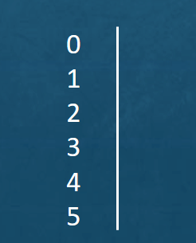
Step 3 (1)
Step 3 is to create a display using the leading digit as the stem and the trailing digit as the leaf. We will identify the stem unit as representing the ten's place. Then we will list each of the ten's place digits that are represented in the data set.
We will separate the stems from the leaves using a vertical line.
Stem unit = 10

Slide 9
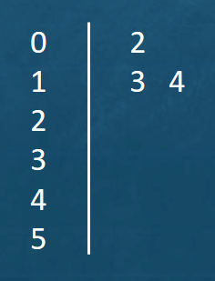
Step 3 (2)
List the corresponding one's place values. Our first data value will be 2. In the next row we will place a 3 and a 4 to represent the data values 13 and 14.

Slide 10
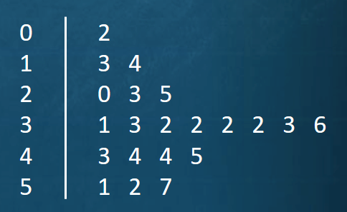
Step 3 (3)
Continue this process until each value in the data set is represented.

Slide 11
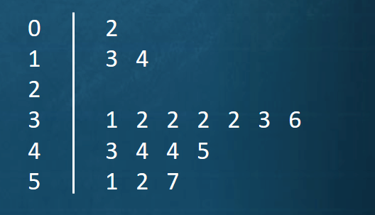
No Data Values
In a case where there are no data values in a class you should write the stem number and leave the leaf row blank.
For instance if this data set had contained no values in the 20 to 29 range then we would have listed the 2 representing 20s but left that row blank.

Slide 12
Benefits
Some benefits of a stem and leaf display are the following:
Easily determine the minimum and maximum values
See the clustering of data
Idea of how the data values are distributed.

Slide 13
Summary
In this PowerPoint we learned how to construct a stem and leaf plot.

